Slide 1
Collections
Where, What, How, Who, and Why?
Notes:
Let’s talk about collections and collecting today. First, think about what you know about collections and collecting. Using the question words, what are some questions you can ask about collections? (Answers:Where are collections? What are they? How do they get there? Who collects things? Why do we collect things?)

Slide 2
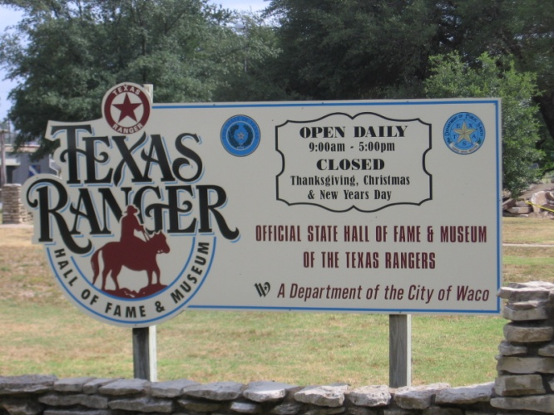
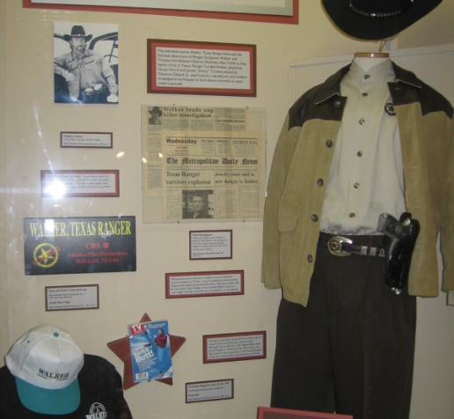
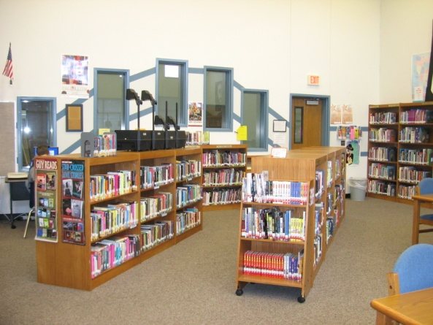
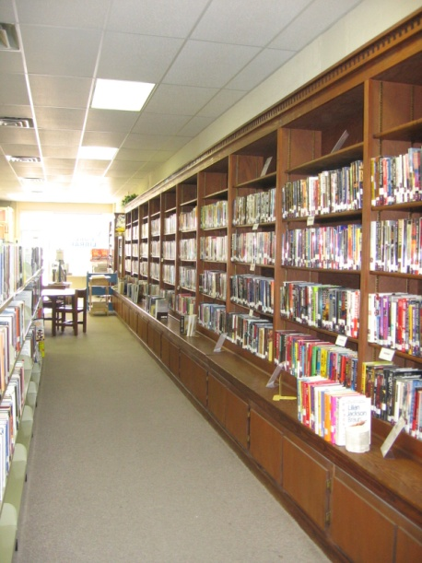

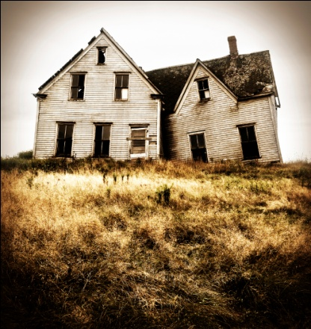
Where?
Where do we find collections?
Museums
Libraries
Grandma’s attic
Under your bed
Notes:
Let’s look at where we find collections. Can you think of any places? Collections can be found in (read from slide). Texas Ranger Museum and display, RROC museum, Florence Public Library, and an attic or bed like yours. Do you have any collections in your home? Where do you keep them?

Slide 3
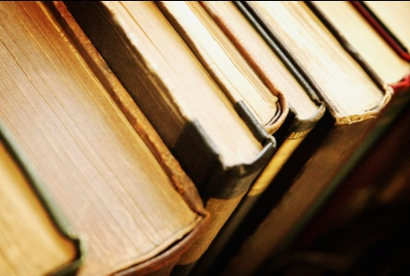
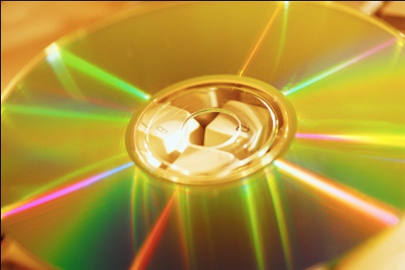
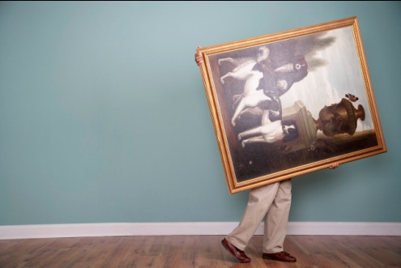
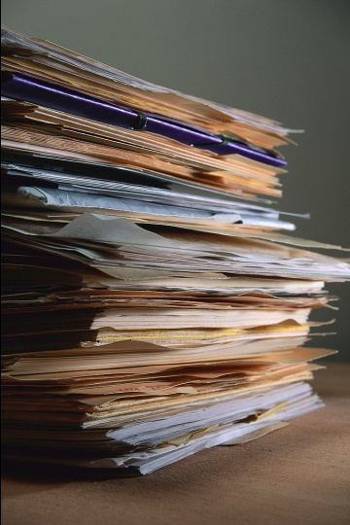
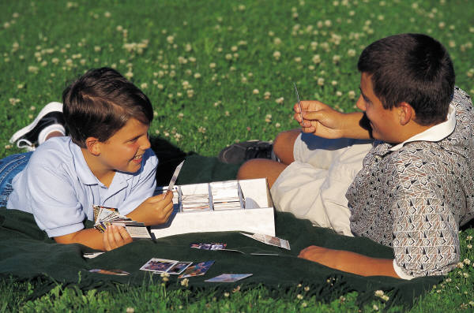
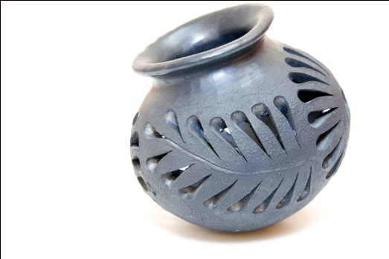
What
What is in a collection?
Books
Videos
Art
Papers
Photos
Pokemon cards
Silly Bands
Realia
Notes:
What can be collected? (Ask for ideas before clicking) (Click through the list) Does anyone know what “realia” is? “Realia”, according to Merriam-Webster.com, are objects or activities used to relate classroom teaching to the real life especially of peoples studied—things like clothes people wear, artwork, or artifacts.

Slide 4
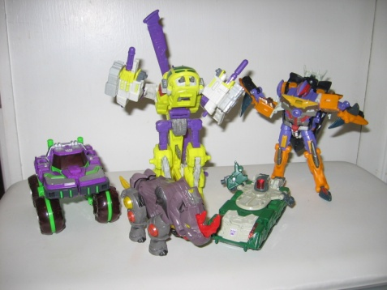
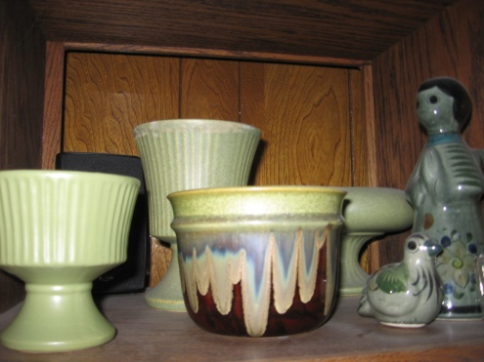
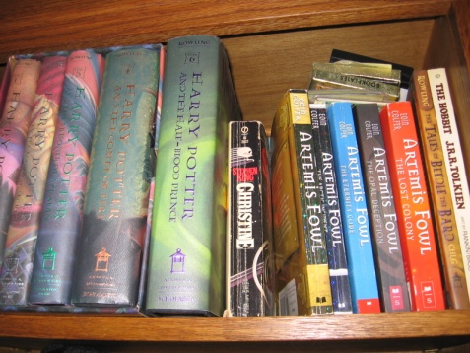
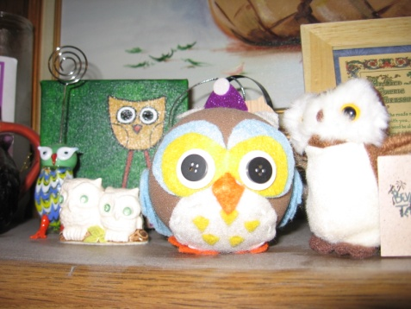
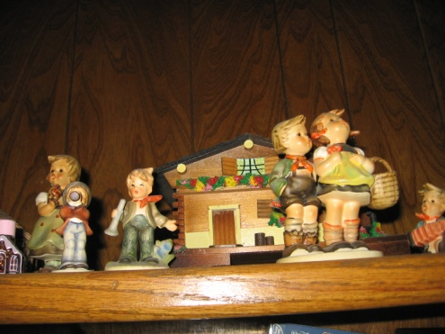
What are some descriptions of a good collection?
Interesting items
All the items connected somehow
Only one or two of the same exact item
Sentimental, monetary or historical value
Notes:
So what do you think makes a collection a good one? What kind of collections do you have? Do they fit the criteria on the slide? Can you think of any other criteria that makes a collection worthwhile? In my house, we have lots of collections: M&Ms dispensers and toys, videos, books, figurines, pottery, photos, art, and owls.

Slide 5
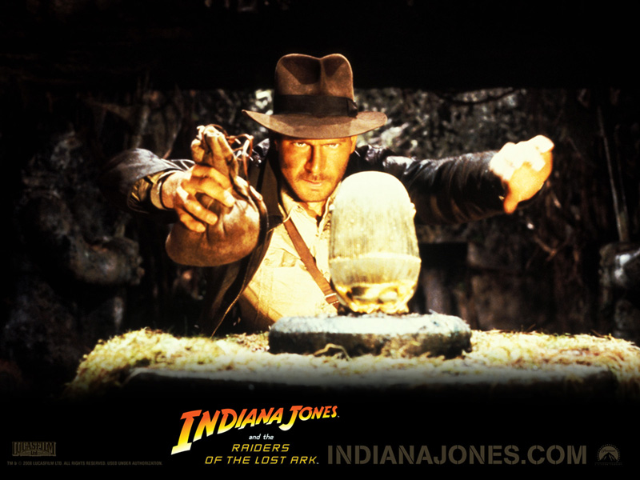
How
How do collections get to those places we talked about before?
Bought
Donated
Searched and found
Click here for an article on collecting
Notes:
Have you ever wondered how items get into collections in museums and libraries? Well, let’s think about how items have gotten into your own collections. (solicit answers) You may have gone out and bought what you wanted, or maybe someone gave it to you as a gift—like a donation. Maybe you have to go out and search for the items, like special rocks…or artifacts like Indiana Jones does in the movies!

Slide 6
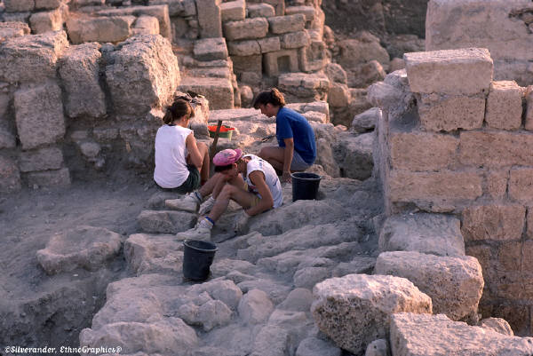

Who
Who does the work of collecting/ caring for collections in libraries and museums?
Curators
Archaeologists
Anthropologists
Librarians
Conservators
Notes:
So now that we know where collections are kept, what makes a good collection, and how collections are built….let’s think about who does the work of collecting the items for libraries and museums? Are there really people like Indiana Jones in real life? What jobs are there in collections development? (click to bring up jobs) Curators help choose and get the items found in museums. They get to decide if exhibits are permanent, or temporary, and they write about them in catalogs. They also have to verify if the items they receive are real. Archaeologists study artifacts from the past, while anthropologists study human behavior and culture. Librarians are responsible for collections of books and items in libraries, and conservators help repair and conserve art and artifacts. Most of these jobs require master’s degrees. If you like collecting, these could be the careers for you!

Slide 7
Why
Why do we have collections?
They make us happy.
They connect us to our family and culture.
They teach us something.
They have either monetary or historical value.
Notes:
Why do we collect things? (solicit answers) Let’s see if your reasons match the ones listed here. Look at (or think about) the collection in our library. What do we have available? Why do you think it’s in here? How can we use the materials?

Slide 8
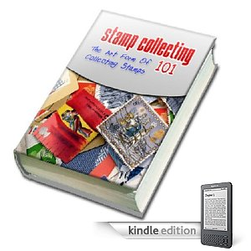
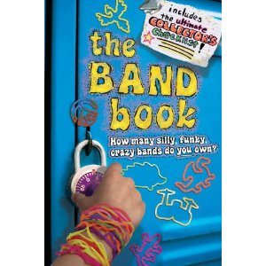
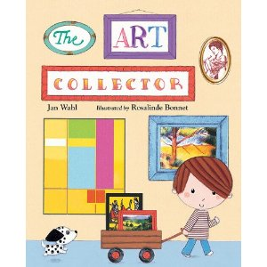
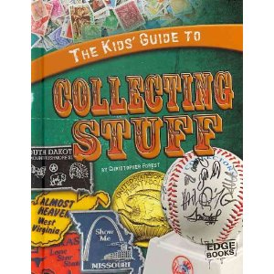
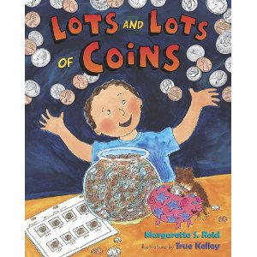
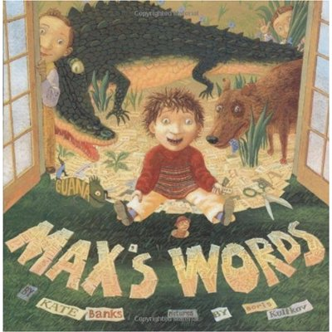
Here are some books on collecting you may enjoy:
Notes:
Here are some books on collecting that you may enjoy: “The Art Collector” by Jan Wahl, “Lots and Lots of Coins” by Margarette S. Reid, “The Kids’ Guide to Collecting Stuff” by Christopher Forest, “Stamp Collecting 101”, a kindle ebook, “the Band book”, a guide to collecting silly bands, and “Max’s Words” by Kate Banks, about a boy who collects words.

Slide 9
Sources
Photos of RROC Library, Florence Public Library, Texas Rangers Hall of Fame/ Museum (all slide 2), and collections (slide 4) taken by Chris Margocs.
Image of Indiana Jones downloaded from official website:
http://www.indianajones.com/site/index.html
Images of book covers from www.Amazon.com
All other clip art from Microsoft ClipArt files.
Definitions from the following:
Curator-- http://careers.stateuniversity.com/pages/548/Museum-Curator.html
Archaeologist-- http://www.princetonreview.com/Careers.aspx?cid=10
Anthropologist-- http://www.thefreedictionary.com/anthropologist
Conservator-- www.dictionary.com
Realia-- www.Merriam-webster.com
For additional information on this presentation, contact Chris Margocs at cmargocs@sbcglobal.net for accompanying document entitled “Children, Collecting, and Collections”.

Slide 10
Multimedia Project for LS 5375.03
SHSU MLS Program, Summer I 2011
Chris Margocs

